Slide 1

Federal Agency Panel
Maria Queen, HUD
Sarah Oberlander,HHS
Norris Dickard, ED
Eugene Schneeberg, DOJ
Edna Primrose, DOL
October 31, 2011
Notes:
1

Slide 2
Federal Panel
Panelists from the federal agencies comprising the Forum’s Federal Coordination Team (FCT) will provide status updates for their agencies, to include feedback from the Forum city site visits and overview of each agency’s Action Plan.
This session will include Q & A.
Notes:
2

Slide 3
Department of Housing and Urban Development
HUD’s COMMITMENT TO THE FORUM ON YOUTH VIOLENCE PREVENTION
Designated local HUD Administrators to address HUD-related matters
Raised the profile of housing as an essential element in preventing youth violence
Connect local Public Housing Authorities (PHAs) to the broader work of the Forum
Actively engage youth living in HUD-assisted housing with local Forum efforts
Build on existing efforts of HUD’s Center for Faith Based and Neighborhood Partnerships to offer customized technical assistance
3

Slide 4
HUD Commitment
Utilize existing efforts/expertise of HUD’s Office for International and Philanthropic Innovation
Connect the applicable Forum localities to the Strong Cities, Strong Communities Initiative, Choice Neighborhoods Program, and other local HUD initiatives.
HUD contact information: www.hud.gov
Maria Queen, HUD Liaison, Federal Interagency Youth Initiatives
202.402.4890, Maria-lana.queen@hud.gov
David J. A. Carradini, Program Advisor
HUD Center for Faith-Based and Neighborhood Partnerships
202.402.3618, David.J.Carradini@hud.gov
Sarah Gillespie, Coordinator, Philanthropic Research and Initiatives
Office for International and Philanthropic Innovation
202.402.5843, sarah.b.gillespie@hud.gov
4

Slide 5



U.S. Department of Health and Human Services
Partnership: think outside the box
Youth development approach
Prevention requires different data
Notes:
5

Slide 6

U.S. DEPARTMENT OF EDUCATION
Office of Safe and Healthy Students
“Improving Conditions for Learning”
6

Slide 7
OSHS – What We Do!
Supporting Student Success
7
School Climate Improvement
Bullying prevention
Mental Health
Physical Education
Substance abuse prevention
Violence prevention
Emergency Management

Slide 8
Grant Programs FY 12
8
Safe and Supportive Schools Grants (state)
Emergency Management
Safe Schools, Healthy Students Grants
Physical Education Program (aka PEP)
21st Century Learning Centers Program (state)
Promise Neighborhoods
www2.ed.gov/about/offices/list/index.html
Office of Elementary and Secondary Education

Slide 9
Technical Assistance Centers
9
Safe and Supportive Schools (S3) TA Center (http://safesupportiveschools.ed.gov)
Higher Education Center, AODV Prevention (www.higheredcenter.org)
Readiness and Emergency Management (www.remstacenter.org)
www.findyouthinfo.gov
www.stopbullying.gov

Slide 10
Stay in Touch – we are here to serve you!
10
ED’s Safe & Supportive Schools e-Newsletter
OSHS grants, related federal grants, foundation funding, research, resources…
MUCH, MUCH, MORE – and its free!!!
www2.ed.gov/news/newsletters/listserv/preventioned.html

Slide 11
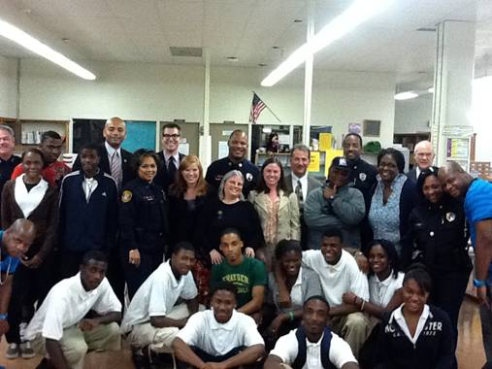

U.S. Department of Justice
Commitment to the
National Forum on Youth Violence Prevention
Notes:
11

Slide 12

DOL - Support for the National Forum on Youth Violence Prevention
U.S. Department of Justice
Commitment to the
National Forum on Youth Violence Prevention
U.S. Attorneys Offices will continue to provide strong local leadership
BJA & OJJDP site coordinators will continue to be responsiveness to TTA requests & assist with support for Peer to Peer Visits.
COPS Office will provide support and guidance to Forum localities in the form of TA on Community policing approaches and data sharing
OVW through active leadership and participation in the Forum will meaningfully connect the issues of teen dating violence, sexual assault and stalking with the broader work of the Forum.
OCOM will continue to work to generate positive media coverage and conduct congressional outreach to support Forum events and activities.
DOJ leadership will continue to demonstrate commitment for the Forum through annual convenings, site visits, and through outreach to Philanthropic, Corporate, and faith and community based stakeholders.
Notes:
12

Slide 13

U.S. Department of Labor
Support for the National Forum on
Youth Violence Prevention

Slide 14
DOL - Support for the National Forum on Youth Violence Prevention
Action Plan Activities:
Increase regional/state/local input
  Participation in site visits & local activities
  Information flow – employment & training options
  Promote the Forum’s achievements
Training/technical assistance
  Participation from additional DOL agencies
Expanded Forum partnerships
  Follow-up from site visits
  Contact: primrose.edna@dol.gov
  (202) 693-3100

Slide 15
Questions?
Notes:
15

